Slide 1
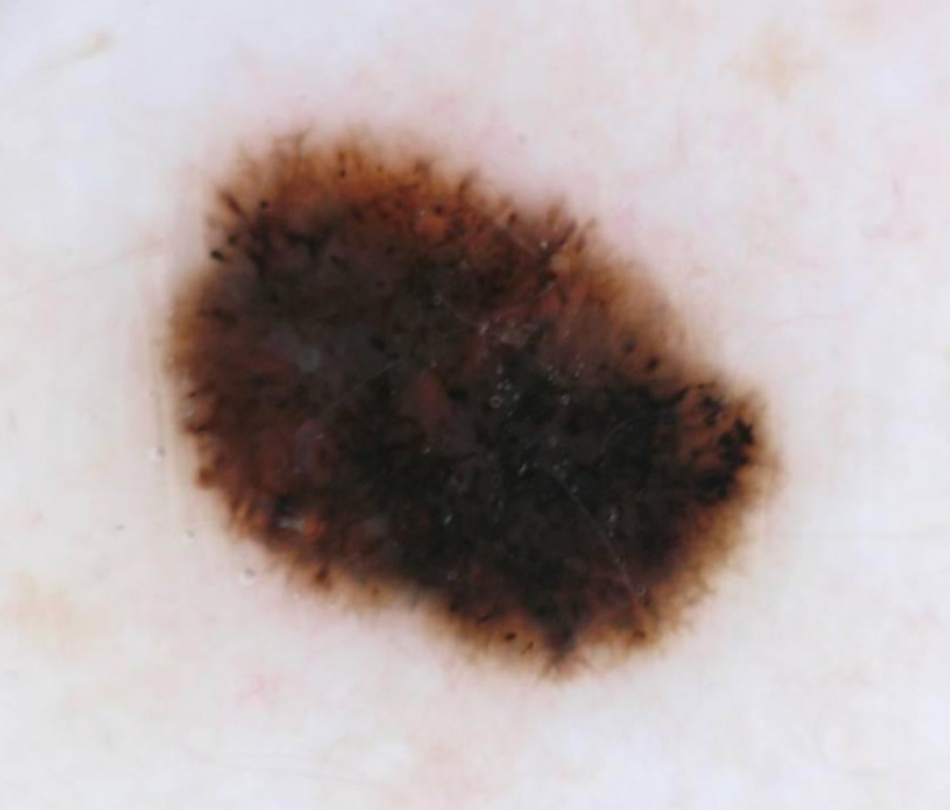

Ninth ISIC Skin Image Analysis Workshop @MICCAI 2024
Organizers:
M. Emre Celebi Catarina Barata Allan Halpern Philipp Tschandl Marc Combalia Yuan Liu

Slide 2
Outline
ISIC Challenges & Workshops
2024 ISIC Workshop
Statistics
Awards
Program
Acknowledgments
ISIC Postdoc Position

Slide 3
ISIC Challenges & Workshops
Skin Lesion Analysis Towards Melanoma Detection/Skin Image Analysis
Organizers: Barata, Celebi, Codella, Combalia, Dana, Gutman, Halpern, Helba, Kittler, Liu, Rotemberg, Tschandl, etc.
IEEE Int. Symp. on Biomedical Imaging (ISBI 2016, 2017)
Int. Conf. on Medical Image Computing & Computer Assisted Intervention (MICCAI 2018, 2019, 2020, 2023, 2024)
IEEE/CVF Conf. on Computer Vision & Pattern Recognition (CVPR 2019, 2020, 2021)
European Conference on Computer Vision (ECCV 2022)

Slide 4
Workshop Statistics
24 submissions received
5 submissions accepted (≈21%)
26 reviewers
59 review reports
≈2.5 reviews per submission on average

Slide 5
Workshop Awards
To be announced in October:
Best Paper Award
Honorable Mention Award

Slide 6
Workshop Program
Opening Rmks. (1:30−40) Inv. Talk 1 (1:40−2:05)
Bonus Break (2:05−20) Oral Pres. 2 (2:20−40)
Short Break 1 (2:40−50) Oral Pres. 3 & 4 (2:50−3:30)
Coffee Break (3:30−4:00) Inv. Talk 2 (4:00−25)
Oral Pres. 5 (4:25−45) Short Break 2 (4:45−55)
Inv. Talks 3 & 4 (4:55−5:50) Closing Rmks. (5:50−6:00)

Slide 7
Acknowledgments
We would like to thank our
Sponsor, Canfield Scientific Inc.
Invited speakers
Authors
Reviewers
MICCAI 2024 Workshop Chairs

Slide 8
ISIC Postdoc Position
More information during Invited Talk 4 (5:20−50)

